Slide 1

Hadoop

Slide 2


Block of data
What is meant by a block?
Block is a smallest unit of physical memory, where data is stored.
Smallest unit of a file system to store the data.
Smallest continuous location in RAM for storing data.
Text File (Raw data)
HDFS
Store the data
Suppose we want to store 1024 MB of data. How many blocks
of data will be created?

Slide 3
Block of data
First, we must know the size of a block?
Hadoop 1.X version
64MB (default block size)
Hadoop 2.X+ version
128MB (default block size)
Now, how many blocks will be created?
8 blocks

Slide 4
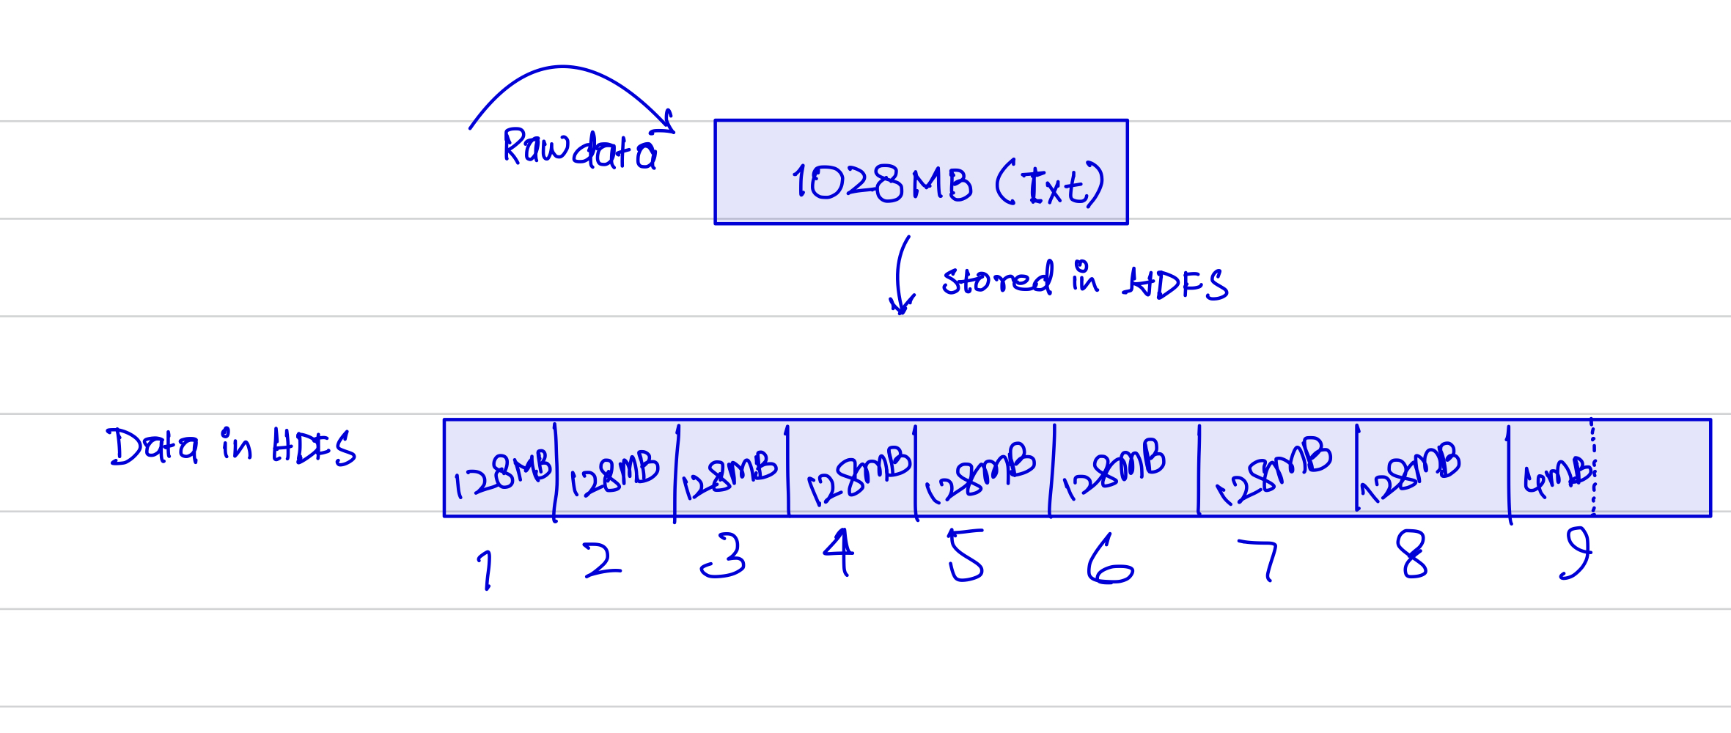
Block of data
What if we have 1028MB data? How many blocks will be created?
9 blocks

Slide 5
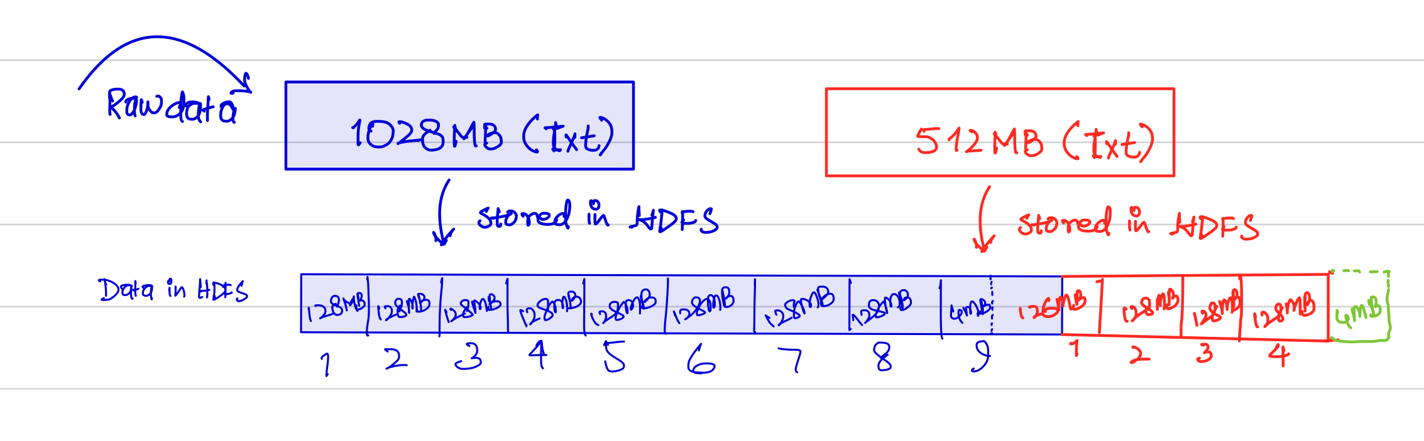
Block of data
Q: What do you think, Block-9 (B9) will be wasted?
No, it will be used for the next data.
Note: Memory must be continuous and memory management is
done by namenode (Master coordinator)

Slide 6
Replication management system.
Why replication in distributed system?
As we know that data are stored on multiple DNs, for which data is divided into multiple blocks.
We also know that there is chances of failure of any DNs causes losing of data which is not affordable.
To provide the fault tolerance, replication management comes into play
NameNode
DataNode I
DataNode II
DataNode III

Slide 7
Replication management system.
Selection of block store on which DN is performed by ?
NameNode
DataNode I
DataNode II
DataNode III
NameNode
How many copies of 1 block will be created?
There is a parameter called “Replication Factor”, which decides how many copies will be created.
Default value of RF = 3

Slide 8
Replication management system.
If we want to store 10GB of data, then how much actual memory will be occupied in HDFS?
30GB
What if we increase the replication factor?
Too much memory will be required
Too much overhead on the namenode
What if we decrease the replication factor?
Less memory will be required
Less overhead on the namenode but chance of losing data is too high

Slide 9
Replication management system.
Without replication
NameNode
B1,B2
B5,B6
DataNode I
DataNode II
DataNode III
B1 and B2 will be lost
B3,B5
In replication, we can recover data due to having multiple copies on various DNs.

Slide 10
Replication management system.
Rack Awareness
What do you think, how the NN and DNs are connected?
They are connected via Switches (NN and DNs in cluster)
If the replication is done in the same rack → we may lose the entire data due to failure of that switch.
So, the replication should be done in different racks
While replicating data, namenode must know the rack information → Rack Awareness

Slide 11
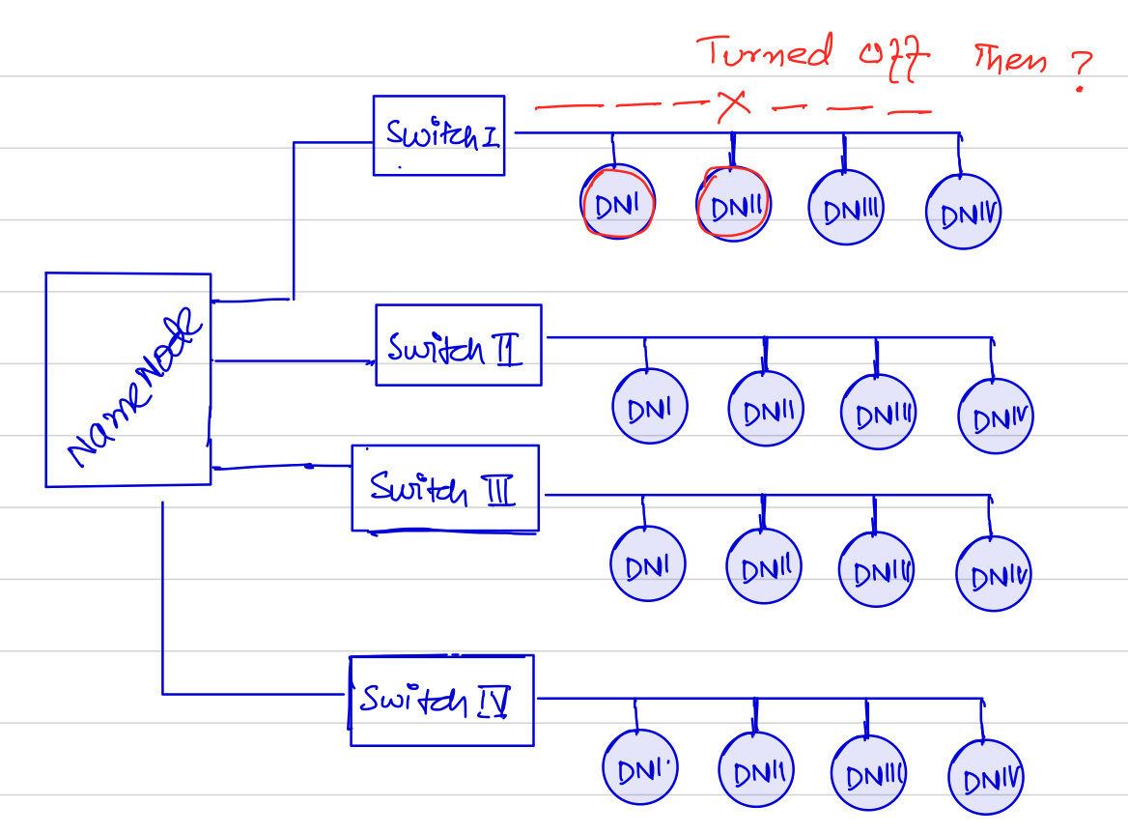
Replication management system.
Rack Awareness

Slide 12
Writing data in HDFS
HDFS Write Request:

Slide 13
Writing data in HDFS
The complete steps of writing data in HDFS are as follow:
Request to NameNode by the HDFS client to write the data on DNs.
NameNode sends back the IP address of the datanodes where the data and its copies are stored
HDFS client check the status/readiness of the datanodes by sending request to the core switch.
Core switch checks the activeness of the datanodes and send data blocks
Multiple copies are stored on other datanodes on another Rack
An acknowledgment (ACK) need to send to NameNode to update the metadata.

Slide 14
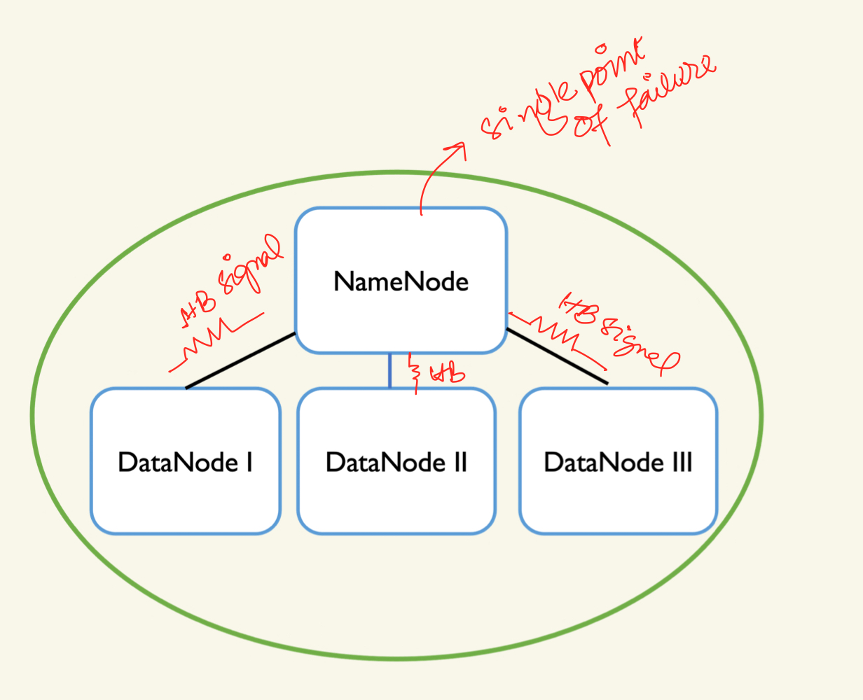
Fault Tolerence
Q: In Hadoop, what is a single point of failure? How to avoid and how to deal with it?
NameNode is gone down (Single point failure)
NameNode maintains all the metadata
DataNodes sends heartbeats to NameNode after a regular interval.

Slide 15
HIGH Availabilty
Q: How to achieve high availability in Hadoop?
There are two ways:
Secondary NameNode
Standby NameNode
Now, we know that NameNode maintains the metadata.
Metadata is related to file system.
All the executed operation e.g., copying, editing, replication info,
deletion of the block etc.
Losing NameNode meaning losing of our File System and we can’t recover the system.

Slide 16
HIGH Availabilty
NameNode is also responsible to maintains the following parts:
FS Image
Edit-logs
FS Image: It contains the complete state of the file system at the start of NameNode (File)
Edit-logs: It contains the recent modifications made to the file system.

Slide 17
HIGH Availabilty

Slide 18
HIGH Availabilty
Q: What do you think. What is important part for the namenode to recover ?
Edit-logs
OR
FS Image
FS Image: It holds the entire state of the system, and we can recover the system instantly.

Slide 19
HIGH Availabilty
High availability = Failure time / downtime should be?
very very less
For a bigger cluster size, the recovery time will be very long
→ Not highly available
Good architecture for recovery
What do you think about this architecture in terms of high availability?

Slide 20
Secondary namenode
Secondary NameNode performs incremental check pointing.
It keeps the latest FS Image as a backup file.

Slide 21
Secondary namenode
The steps involve in recovering the system are shown in the following figure.

Slide 22
Standby namenode
Duplicate of a NameNode
Perform in active-passive mode.
For a particular time one machine (NN) is active and responsible for everything.
For some set of time, another machine (NN) will become active.

Slide 23
Standby namenode
To reduce the recovery time, The DNs send the HBs to both the NameNode and Standby NameNode
FS Image is always sync with standby NameNode.

Slide 24
Standby namenode
The downtime is very less.
Standby is completely responsible in the absence of NameNode.
Less than few seconds.
Very highly available though not 100% highly available.

Slide 25

Resource management
YARN: Yet Another Resource Negogiator
Hadoop 1.X
Hadoop 2.X+
1. HDFS
HDFS → Storage
2. Map Reduce: All the responsibilities of computations along with resource management is performed e.g.,
Data Processing, Resource management
2. Map Reduce → Distribute Computing
3. Yarn → Resource Management

Slide 26
Yarn Architecture
YARN: Yet Another Resource Negogiator

Slide 27
Yarn Architecture
Container:
Small virtual space in physical machine, which consists of some CPU core, memory and bandwidth.

Slide 28
Yarn Architecture
Resource Manager (RM) receives a job request.
RM creates application master inside a container.
Application Master communicates back / ask for the
required resources from RM to complete the requested job.
Assign application ID to Job-1 to identify how much resources are assigned to Job-1.
Application master may ask for multiple resources / containers from RM for a particular Job.

Slide 29
Yarn Architecture
Q1: If we have 1000 jobs to be executed in Hadoop cluster, how many application master should be created?
1000 Application master → each is responsible for 1 Job
Q I1: How yarn identify how much resources are left free and can be allocated another job?
Yarn receives the status of resources (used/free) from the node manager on each datanode

Slide 30
Yarn Architecture
Steps for resource allocation:
Step-1: Client sends a job request to resource manager.
Step-II: RM creates a single container on any DN and start application master service on it.
Step-III: Application master requests RM to create more containers (if required).
Step-IV: RM creates required number of containers on various DNs.
Step V: Containers will process the block of data.

Slide 31
Yarn Architecture
Resource Manager:
Responsibilities are:
Authority to allocate resources.
Optimization of cluster utilization.
It has two components
Scheduler
Application master

Slide 32
Yarn Architecture
Scheduler:
Responsible of allocation resources to the running jobs.
Scheduling the jobs (put them in queue).
Pending Queue: If all the resources are occupied then the scheduler will put the jobs in pending queue.
Priority Queue: Allocate resources or dedicated resources to the high priority jobs.

Slide 33
Yarn Architecture
Application Master:
Responsible for job submission.
Negotiate number of containers from the RM.
Manages running applications.

Slide 34
Yarn Architecture
Node Manager
Daemon service running on each DN.
Responsible of individual nodes in Hadoop cluster.
Sending reports and heart beats to the resource manager along with the health status.
Monitor resource usage (CPU, Memory) of an individual container.

